Slide 1
Underwriting a Development Loan and General Short Term Finance
Eugene Esterkin and Gary Lederberg
Notes:
Notes

Slide 2
Part 1 – Underwriting a Development Loan Criteria Overview
Regulated self builds to development for profit
England, Wales and Scotland
One unit to multiple units (phasing possible)
Up to £2mn (interest only charged on monies drawn)
70% LTV at any point in the build (See further below)
100% funding available (with additional security)
First time to experienced developers
Site visits for complex and / or larger transactions
Notes:
Notes

Slide 3
What We Want To See
Application Form
Income, expenditure, asset and liability form (with bank statements)
Valuation
Build costs and timeline
Planning permission
Building regulations consent
NHBC or other insurance
Affordability (retained interest is offered as an option)
Viable exit strategy within the term of the loan (crucial)
A clean legal title
Notes:
Notes

Slide 4
Loan to Value Calculation
Date | Gross Loan Released | Gross loan running total | Less Fees per release |  | Months of term remaining | Monthly instalment on drawdown | Monthly instalment (running total) | Less | Net loan received by borrowers | Total Property Valuation | Other Borrowings | LTV
 |  |  | Arrangement / Broker | Legal |  |  |  | Interest to end of term
Month 0 | £52,000.00 | £52,000.00 | £3,787.50 | £1,600.00 | 12 | £650.00 | £650.00 | £7,800.00 | £38,812.50 | £225,000.00 | £0.00 | 23.1%
Stage 1
Month 1 | £52,941.18 | £104,941.18 | £0.00 | £0.00 | 11 | £661.76 | £1,311.76 | £7,279.41 | £45,661.77 | £225,000.00 | £0.00 | 46.6%
Stage 2
Month 2 | £72,625.70 | £177,566.88 | £0.00 | £0.00 | 10 | £907.82 | £2,219.59 | £9,078.21 | £63,547.49 | £275,000.00 | £0.00 | 64.6%
Stage 3
Month 3 | £14,933.12 | £192,500.00 | £0.00 | £0.00 | 9 | £186.66 | £2,406.25 | £1,679.98 | £13,253.14 | £275,000.00 | £0.00 | 70.0%
Stage 4
Month 4 | £60,000.00 | £252,500.00 | £0.00 | £0.00 | 8 | £750.00 | £3,156.25 | £6,000.00 | £54,000.00 | £370,000.00 | £0.00 | 68.2%
Stage 5
 | £252,500.00 | £252,500.00 | £3,787.50 | £1,600.00 |  | £3,156.25 | £3,156.25 | £31,837.60 | £215,274.90
Notes:
Notes

Slide 5
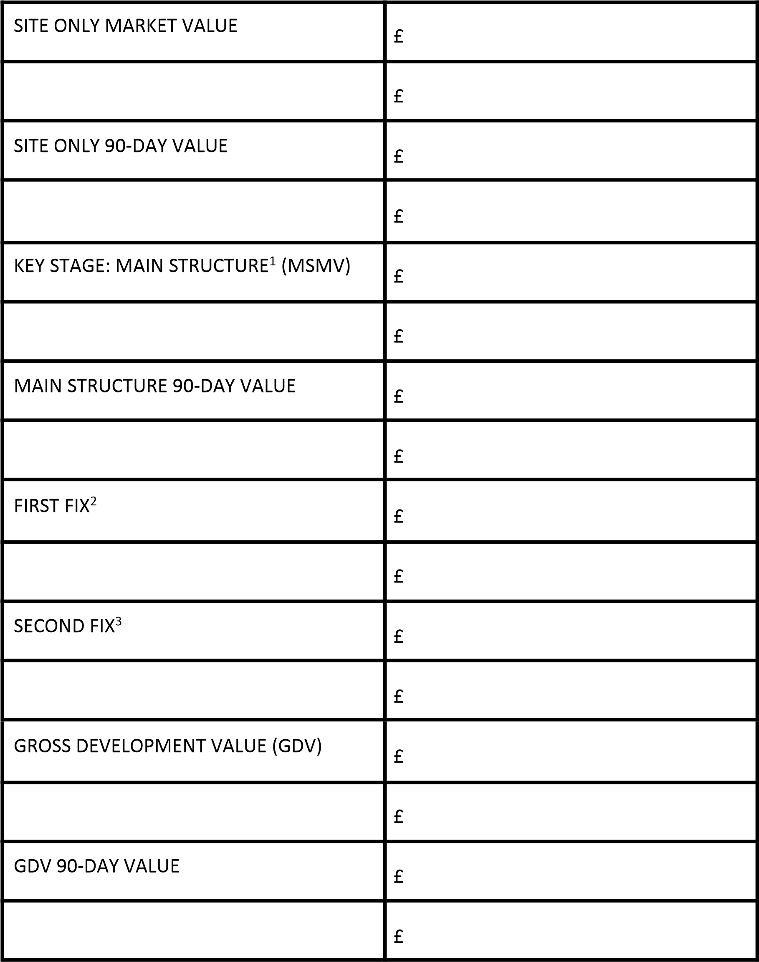
Loan to Value Calculation
¹ Main structure is defined as a structure comprising of walls and roof. The MSMV assumes all necessary certification is in place to comply with building regulations and NHBC or similar guarantees; and that the whole site is suitable for acquisition by another developer, unencumbered.
2 First fix comprises all the work needed to take a building from foundation to putting plaster on the internal walls. This includes construction of walls, floors, ceilings and inserting cables for electrical supply and pipes for water supply.
3 Second fix comprises all the work after the plastering to a finished house but not decorated. Electrical fixtures are connected to the cables; sinks and baths connected to the pipes, and doors fitted into doorframes.
Notes:
Notes

Slide 6
Case Study - Details
Agreed to lend £319,000 (100% of build cost)
Released in stages
Monthly interest payments retained (1.25% pcm)
12 month term
1st charge on land purchased for £225,000 with a GDV of £675,000 per valuation
Notes:
Notes

Slide 7
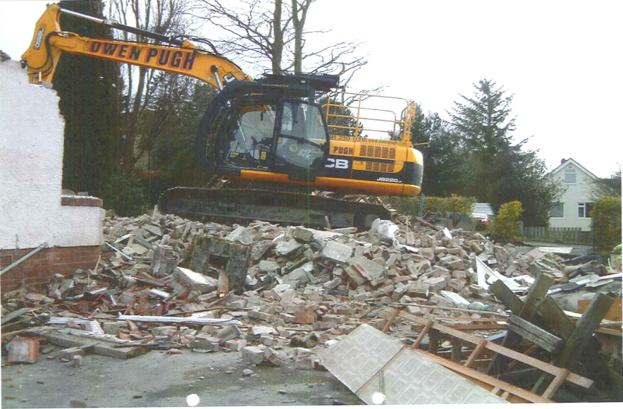
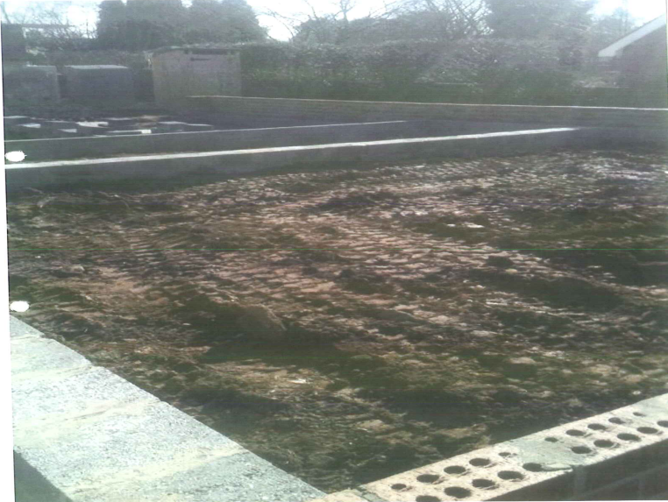
Case Study – Stage 1
£52,000 initial advance (LTV = 23%)
£225,000 valuation
Notes:
Notes

Slide 8
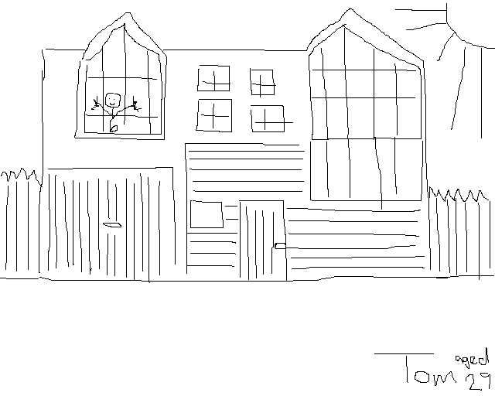
Case Study – Stage 2
£52,941.18 further advance (Total £104,941.18) (LTV = 47%)
£225,000 valuation
Artist’s impression
Notes:
Notes

Slide 9
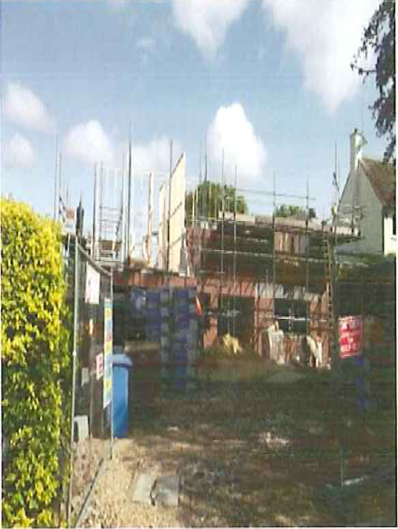
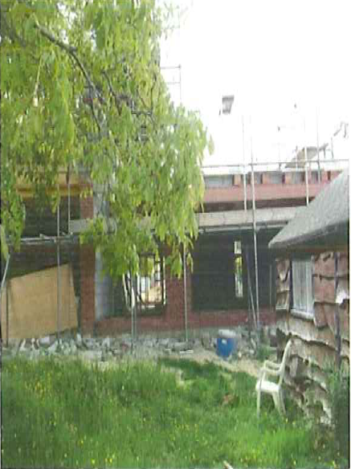
Case Study – Stage 3
£72,625.70 further advance (Total £177,566.88) (LTV = 65%)
£275,000 valuation
Notes:
Notes

Slide 10
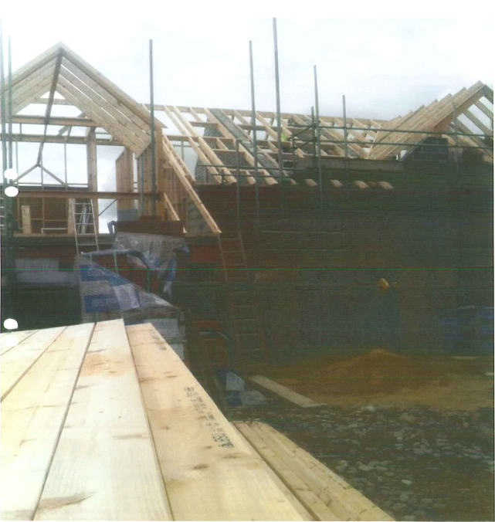
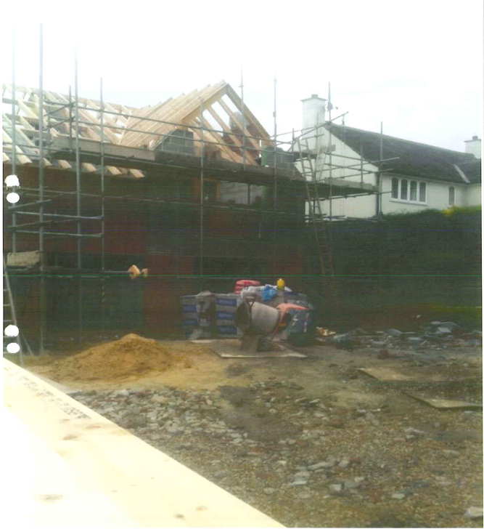
Case Study – Stage 4
£14,933.12 further advance (Total £192,500) (LTV = 70%)
£275,000 valuation
Notes:
Notes

Slide 11
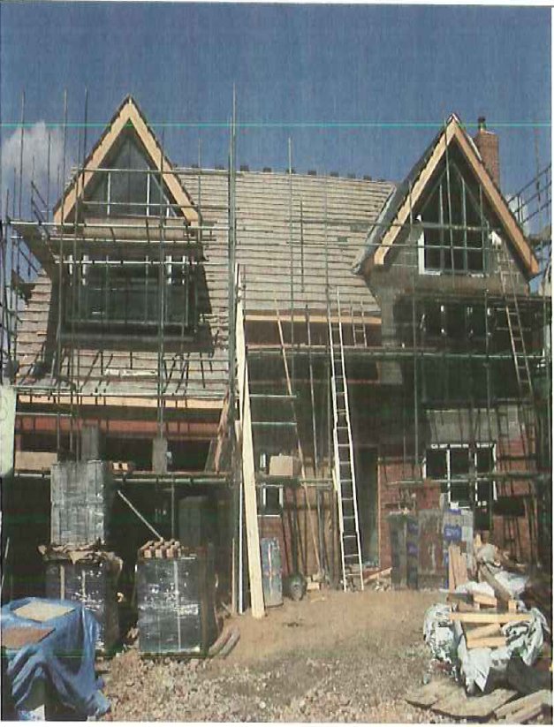
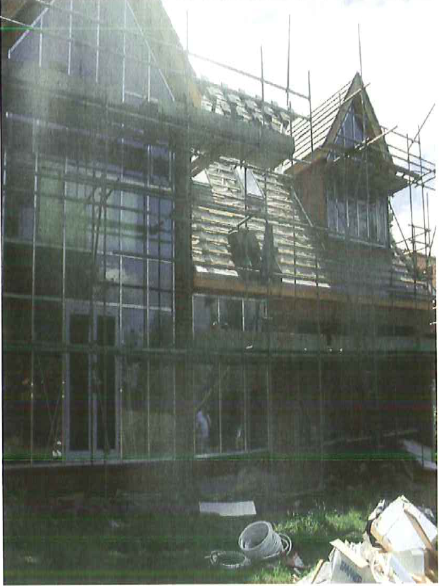
Case Study – Stage 5
£60,000 further advance (Total £252,500)
£370,000 valuation
Notes:
Notes

Slide 12
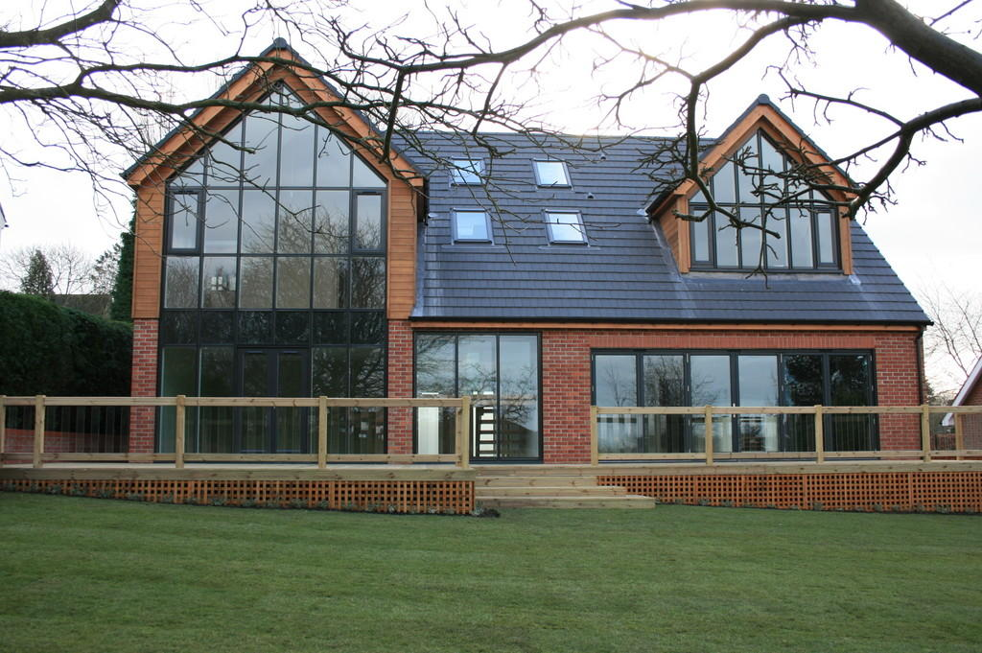
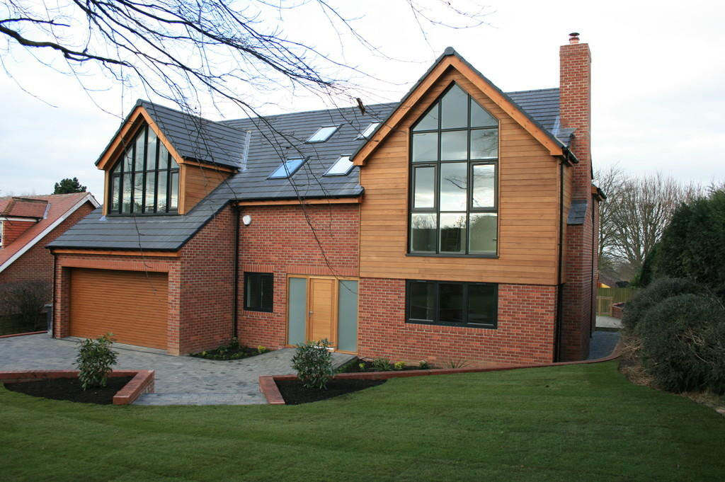
Case Study - Completed
End value of £775,000
Notes:
Notes

Slide 13
Important Features
Pricing
Competition
Timings to completion
Legal points
Commission
Broker Fee
Notes:
Notes

Slide 14
Part 2 – General Short Term Finance Our Lending Brands
Notes:
Notes

Slide 15
Why the Affirmative Group ?
No upfront fees
True balance sheet lending
Common sense underwriting
No hedge funds
On site legal team
On site decisions
Notes:
Notes

Slide 16
Key Lending Areas
FCA Regulated
Development Funding
Land with Planning
Unmortgageable Properties
Auction Purchases
Barn Conversions
Refurbishment Finance
Notes:
Notes

Slide 17
Criteria Details
Acceptable Security
Residential
Commercial
Semi-commercial
BTL / HMO
Land with planning
Non standard construction
Unmortgageable
Unacceptable Security
Hotels
Farms
Pubs / Clubs
Stadia
Golf clubs
Ex-council flats above 6th floor
Time share
Notes:
Notes

Slide 18
Criteria Details (continued)
Any legal purpose
Payment methods (monthly or retained interest)
No missed payments within last 12 months
Aged 21 – 70 years old
Individuals / Partnerships / Limited Companies
England / Wales / Scotland
Notes:
Notes

Slide 19
Questions & Contact Details
7 St James Square
Manchester
M2 6XX
08701 123 111
www.affirmativefinance.co.uk
@AfffBridging
App available from the Apple Store
Notes:
Notes

